Slide 1


Java Programming Structure & Components
IT-2650
Martin P. Walsh, Instructor
Cuyahoga Community College

Slide 2
Basic Programming Logic Structures
All logic problems can be solved by a combination of these logic structures
Sequence – actions must be performed in a specific order (similar to travel directions)
  The order statements are processed, not necessarily their program code line number order
Selection or Decision – answer to a Boolean question results in one of two courses of action being initiated (true action, false action)
  IF statements, Loop statement condition tests
Loop or Repetition – repeat actions while a condition remains true or until a condition changes
  Do…While, While, or For loop statements
Every program must use the Sequence structure. The other two structures (Selection and Repetition) are only used if needed.

Slide 3
Java Application Hierarchy
Package
Class 1
Class 2
Class 3
Main Method
(required)
Method 2
Method 1
Method 1
Method 2
Folders holding source code, images, other resources
.java files
Entry Point

Slide 4
Java Typical Program Components
Package – holder for classes
Class – holder for methods and event handlers
Method – modular block of code for a specific task
Event Handler – code implemented because a specific event occurred (usually a user-initiated event – e.g. Click)

Slide 5
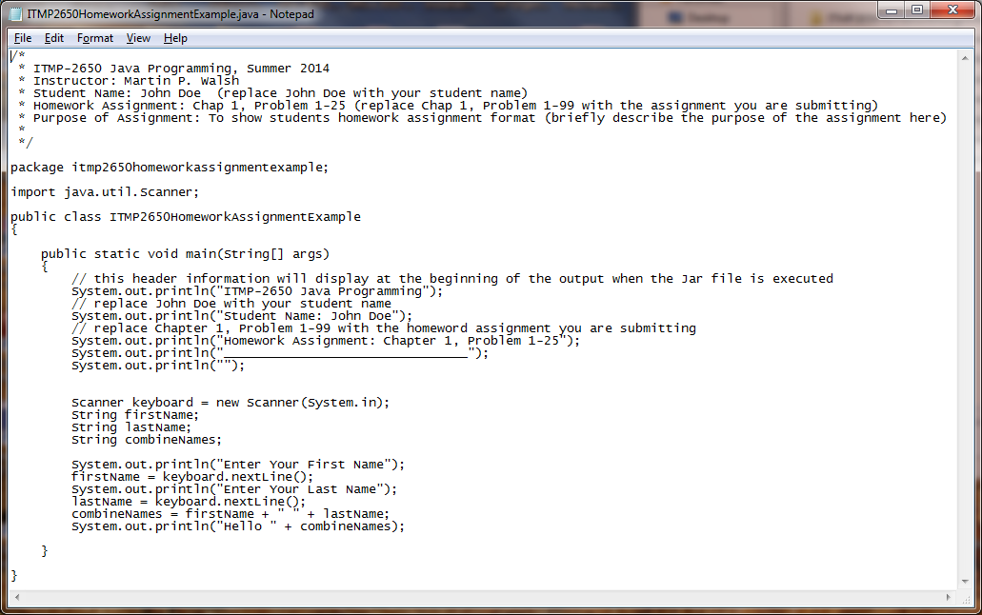
Typical Java Program Parts
Comment block
Package statement
Class import statement
Class statement
Curly brackets “{ }”
Main method statement
Console output statements
Semicolons “;”
Console input statements

Slide 6
Method = Modularized Code
Why modularize code?
  Easier to read, debug, and understand
  Allows multiple programmers to work on a project
  Reusable code – can be used in multiple projects
Method parts
  Header – one-word name (variables, if any)
  Start curly brace {
  Body – code statements
  Return statement, can be omitted
  End curly brace }

Slide 7
Looping and Decision Code
Chap3ComparisonWinApp CodeAnalysis.xlsx
 | Chapter 5 Analysis.cs - Where If Code
Line# | Statement Code
1 | public static void Main(string[] args) | Method
2 | {
3 | // initialize variables in declarations
4 | int passes = 0; // number of passes | Variables
5 | int failures = 0; // number of failures
6 | int studentCounter = 1; // student counter
7 | int result; // one exam result from user
8
9 | // process 10 students using counter-controlled repetition
10 | while (studentCounter <= 10) | Loop
11 | {
12 | // prompt user for input and obtain a value from the user
13 | Console.Write("Enter result (1 = pass, 2 = fail): ");
14 | result = Convert.ToInt32(Console.ReadLine());
15
16 | // if...else nested in while
17 | if (result == 1) // if result 1, | If
18 | passes = passes + 1; // increment passes
19 | else // else result is not 1, so
20 | failures = failures + 1; // increment failures
21
22 | // increment studentCounter so loop eventually terminates
23 | studentCounter = studentCounter + 1;
24 | } // end while
25
50

